Slide 1
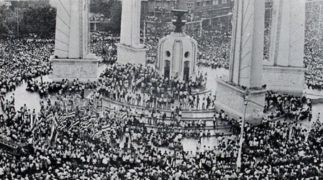
Modern History of Thailand
Modernization to Globalization

Slide 2
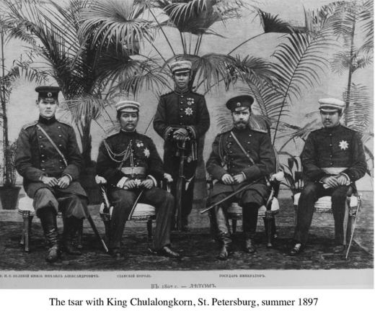
Chulalongkorn: the modernizer
1853-1910
Modernization/ Westernization
1897 First visit to Europe
Strategy to avoid colonization

Slide 3
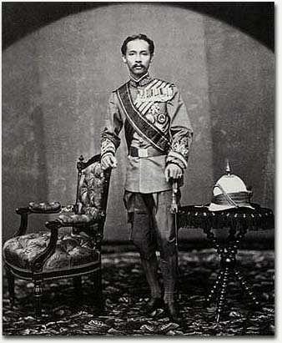
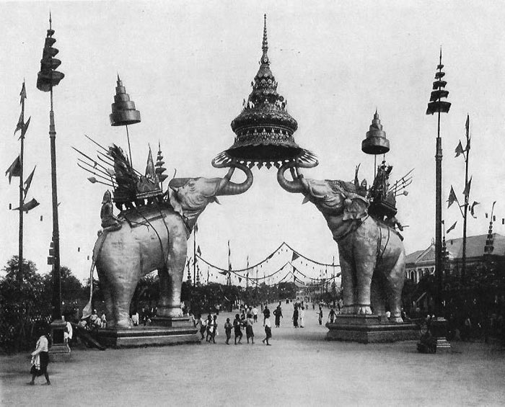
Refashioning Siam
Uniform
Western Schooling
Abolishing slavery
Collecting new objects
Western army

Slide 4
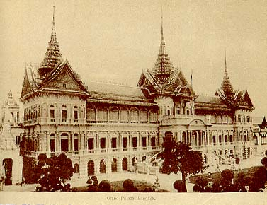
Chakri Throne Hall

Slide 5
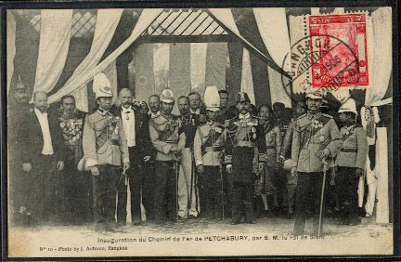
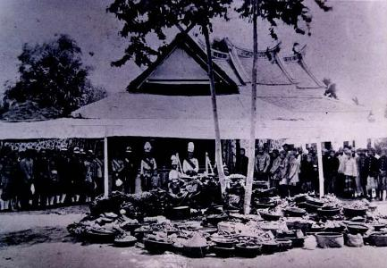
Internal-colonization
Anglo-Siam treaty over Chiang Mai in 1874
Railway expansion
Phumibun revolt (Millenarian movement)
Survey of provinces

Slide 6
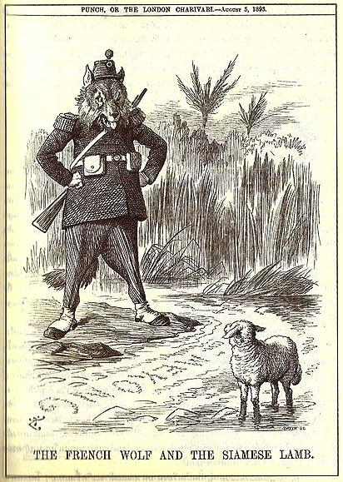
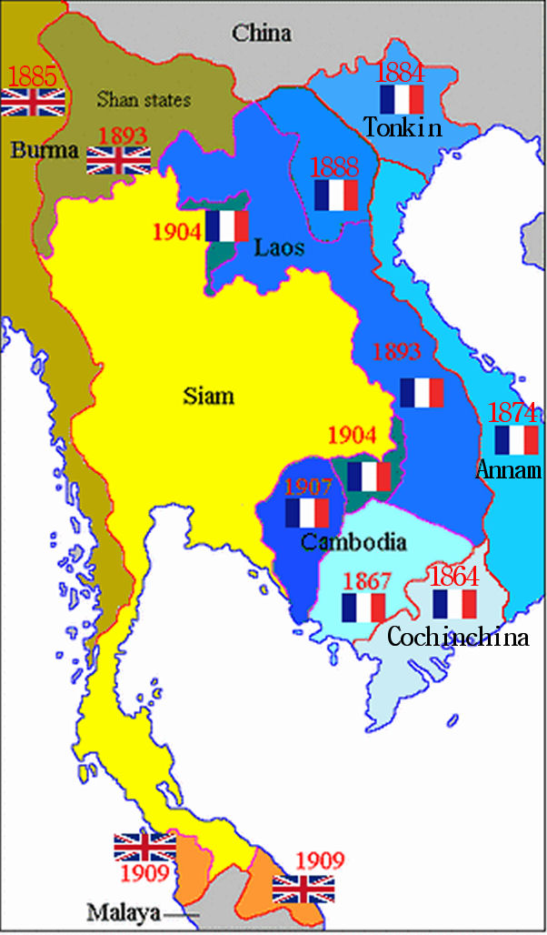
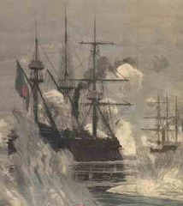
Paknam Incident
French gunboats threaten Bangkok, 1893
Territorial “lost”

Slide 7
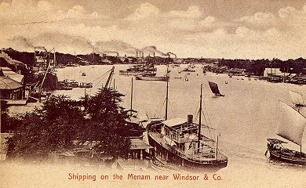
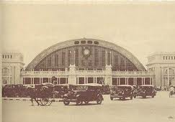
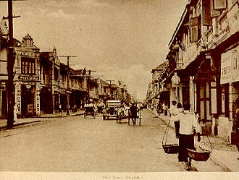
Road-Rail-Steamboat
Chareonkrung road
Hualamphong station
East Asiatic Port

Slide 8
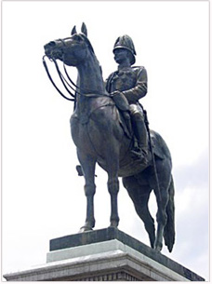
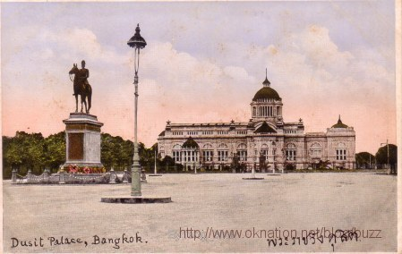
Dusit Palace
New palace complex for absolutist monarch
Equestrian monument

Slide 9
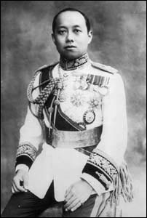
Official Nationalism
Vajiravudh and the creation of Nation
Burmese: external enemy/ Chinese: internal enemy
Jews of the East
Nationality Act and Surname Act

Slide 10
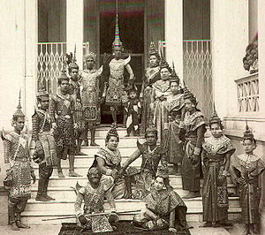
Cult of Nation
Tai Race, by W C Dodd
Our Wars with the Burmese, by Prince Damrong
Historical theme stage performance

Slide 11
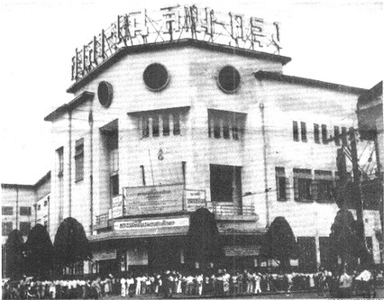
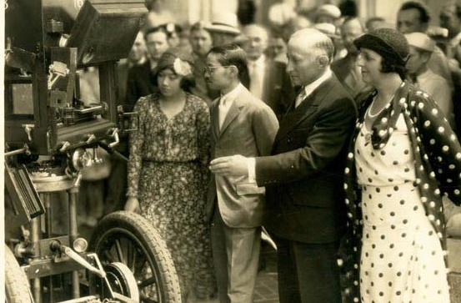
Entertainment in Bangkok
Chalermkrung theatre
Newspaper and caricature criticizing the elite

Slide 12
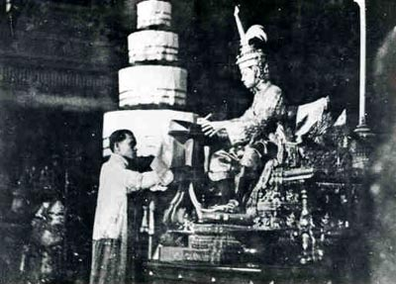
End of Absolutism
24 Jun 1932, Oversea educated military officers and civil servants led this revolution, Great Depression
Transition to constitutional monarchy

Slide 13
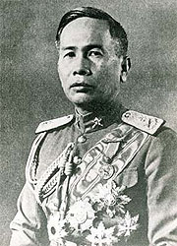
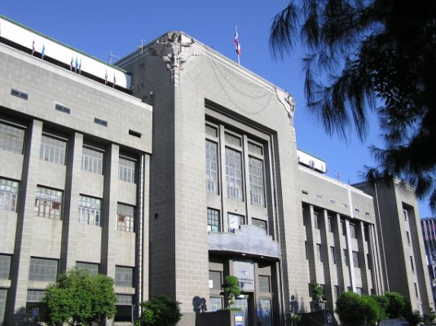
Phibunsongkram
Military factions emerge
Promoted Pan-Thaism
Siam to Thailand in 1939
Fascist Architecture

Slide 14
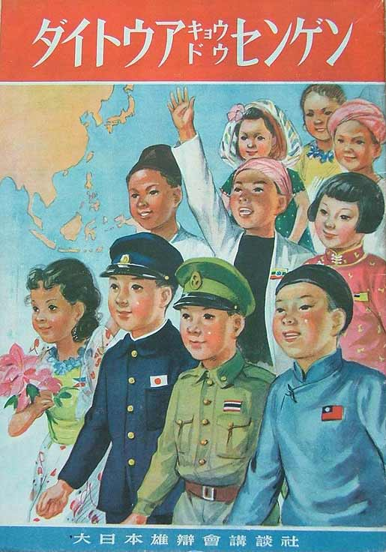
Thailand under the Rising Sun
1941 Phibun sided with Japan
Seized “lost” territories back
East Asia Co-prosperity sphere

Slide 15
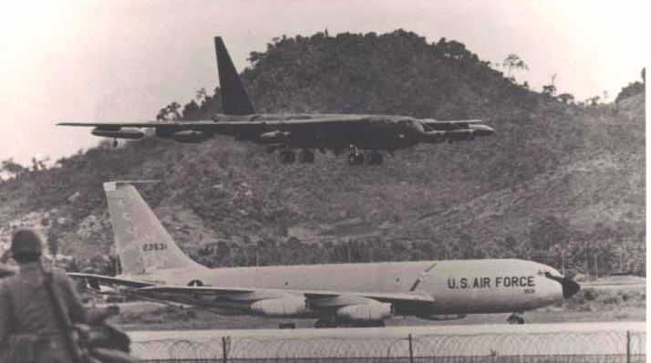
Allied with USA
Thailand was not occupied in postwar
USA as protector from Communist threat
Set up huge military bases (U Tapao, Takli, Udon) in Thailand for bomber in Vietnam War

Slide 16
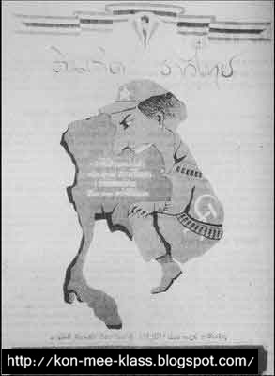
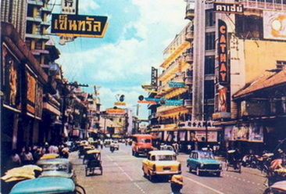
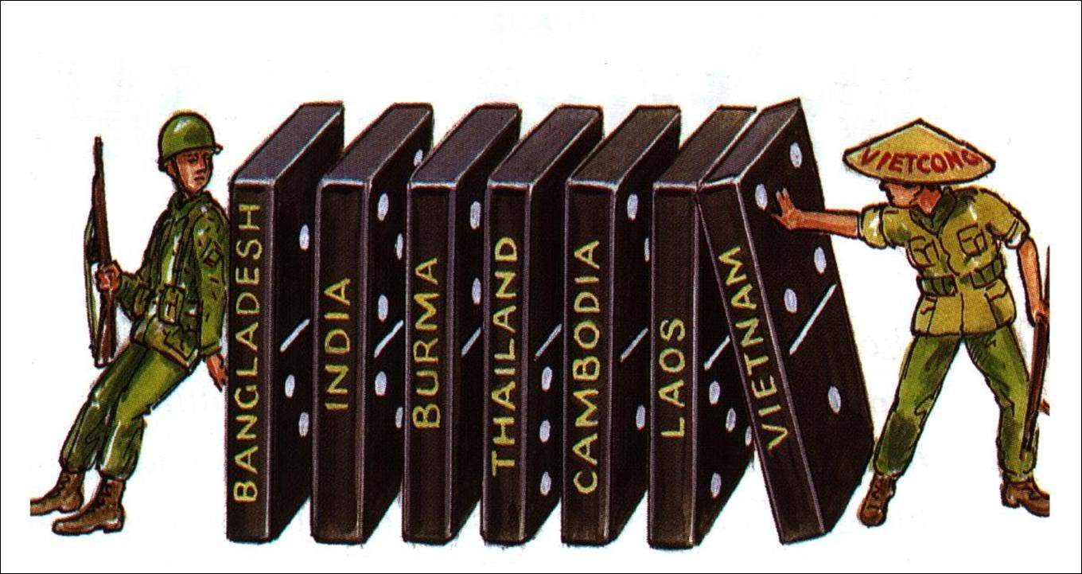
Domino Theory
Friendship Highway
Rise of American Culture
Pax Americana
USAID and US propaganda

Slide 17
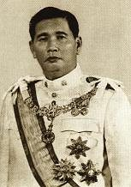
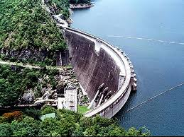
Sarit-Thanom-Praphas Regime
Conservative military dictator
Paternalistic regime
Development project guided by World Bank

Slide 18
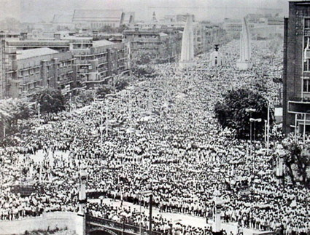
October 1973-1976
Popular protest against dictator
3 years of unstable democracy

Slide 19
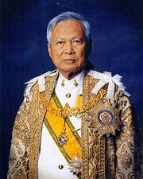
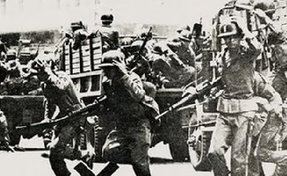
General Prem rules in 1980s
Restored parliamentary politics
Series of failed coup

Slide 20
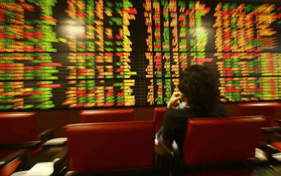
Economic Boom to Bust
Oil crisis led to restructure of Thai economy
Shifted from Import substituted to Export Oriented industrialization
NICs and Tiger of Asia

Slide 21
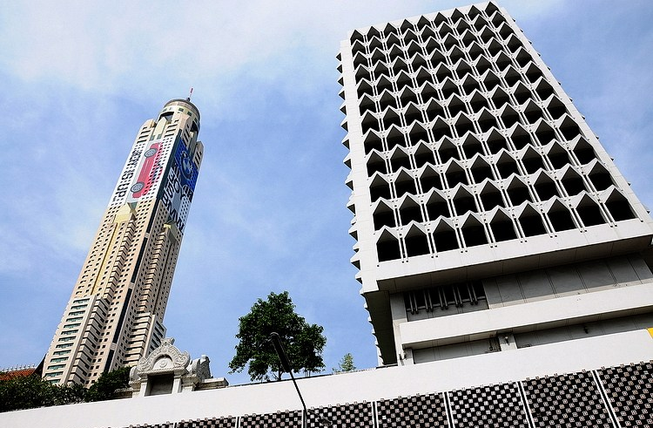
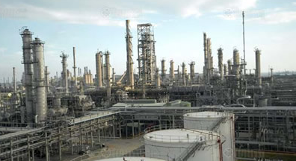
Bangkok & Eastern Seaboard
Laem Chabang-Maptaput complex
Industrial estate
Discovery of Natural Gas
Expressway
Skyscrapers

Slide 22
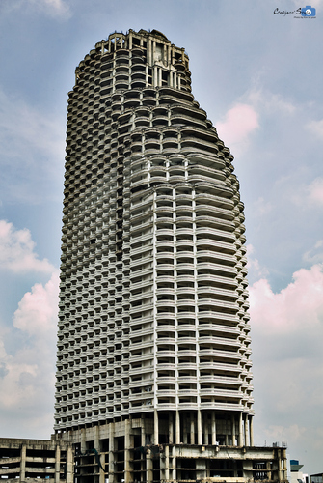
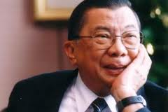
Economic Crisis of 1997
Devaluation of the Baht
Question on globalization
Return to self sufficient, localism

Slide 23
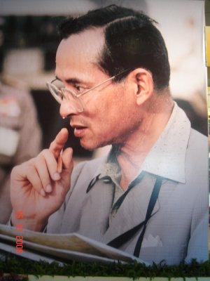
K Bhumipol & Sustainability
Alternative development model
Subsistence economy
Royal development project
Unified factory in Thai society

Slide 24
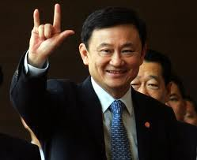
Thaksin Shinawatra Years
Telecom tycoon turn politician 2001-2006
Professional image
Nationalist to populist leader

Slide 25
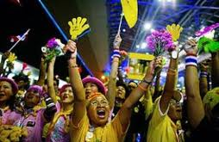
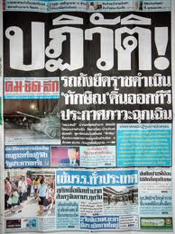
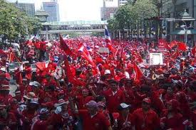
Coup, Protest, Political Crisis, Populism

Slide 26
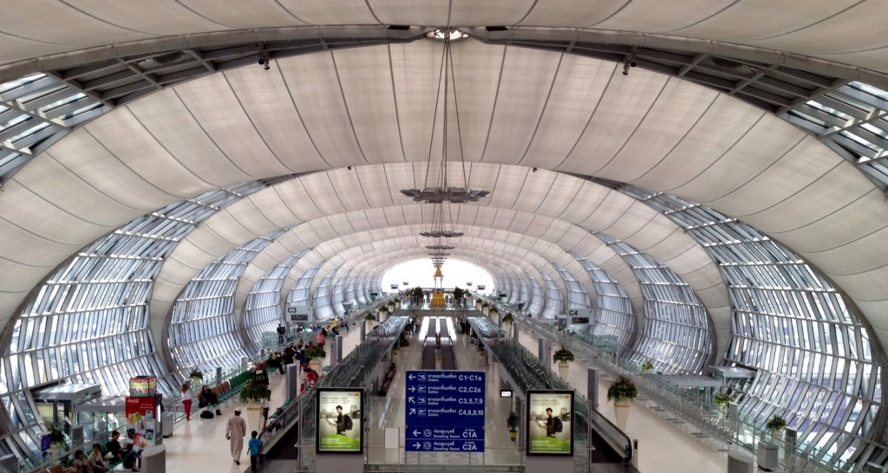
Thailand and the World
Manufacturing/ transportation hub in Global supply chain
Tourism-Spa-Agro business

Slide 27
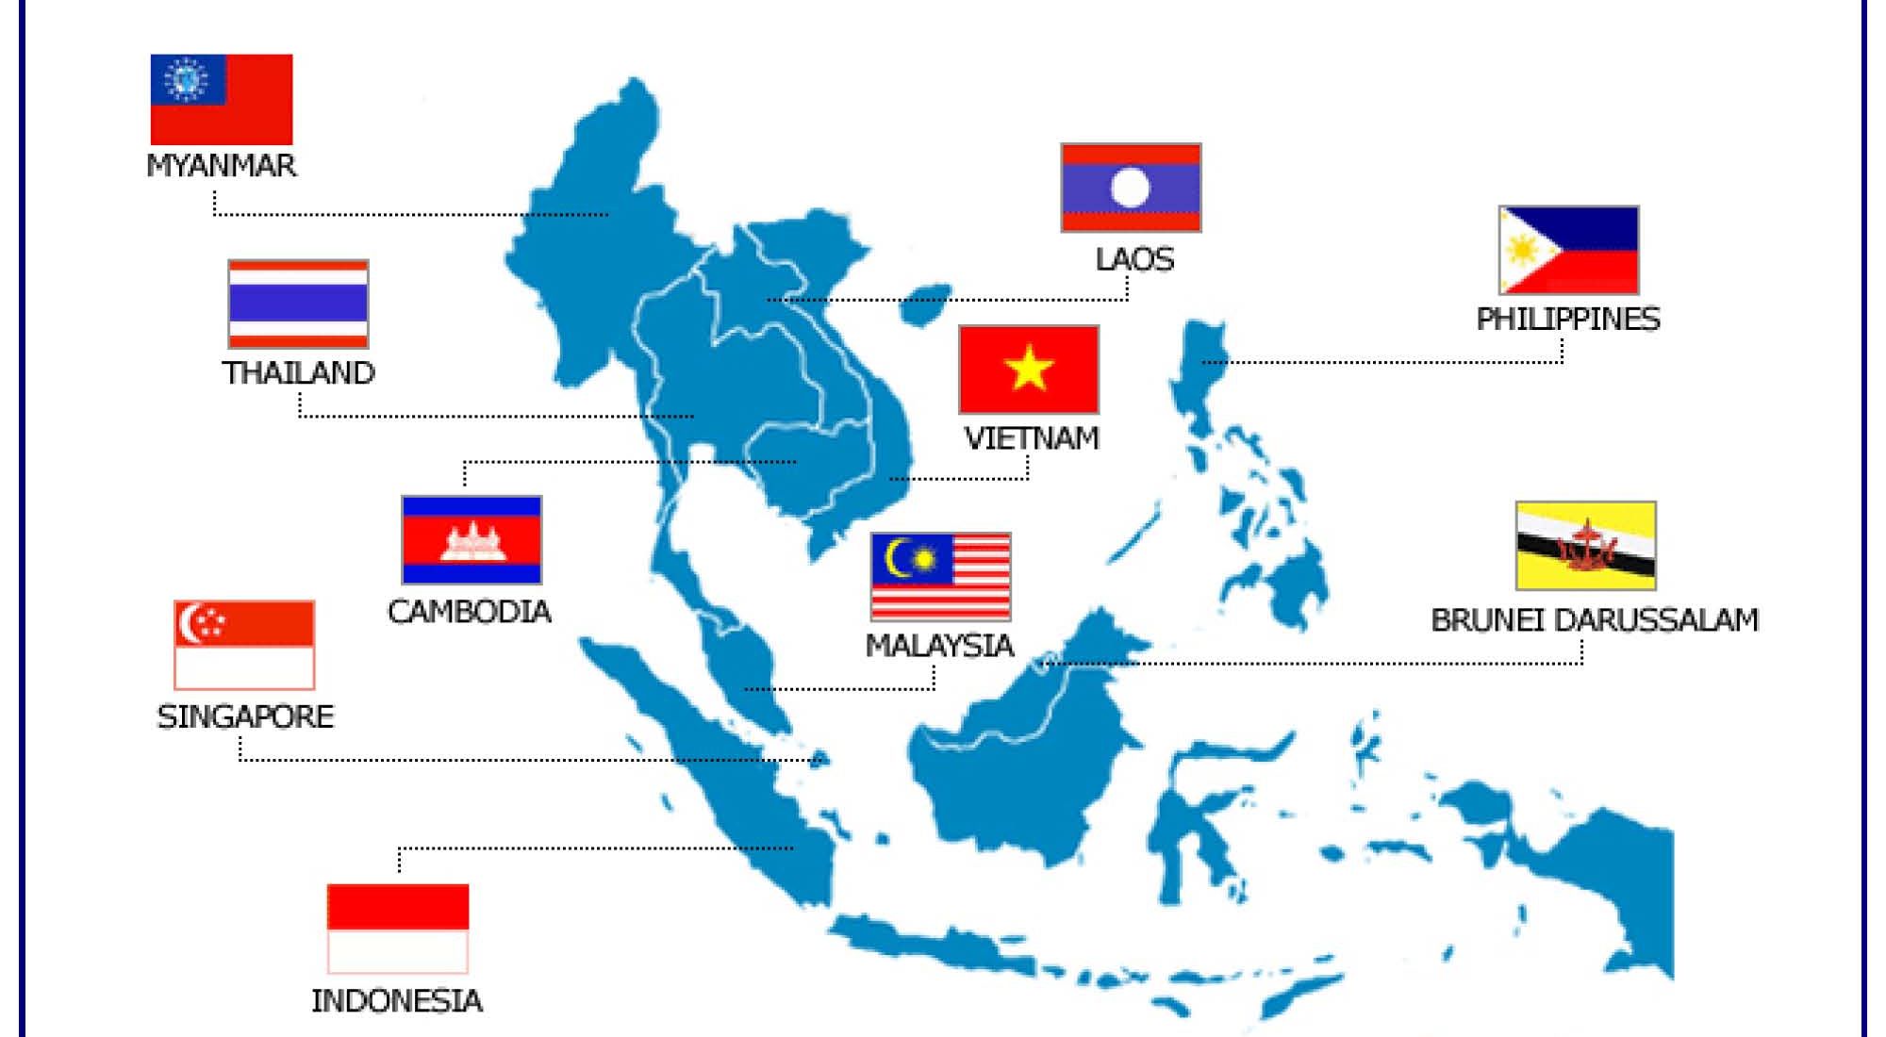
ASEAN & AEC (2015)

Slide 28
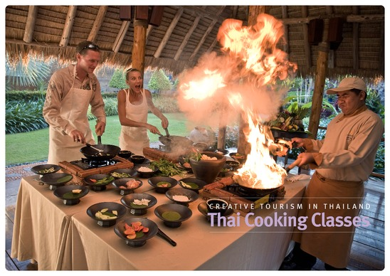
Cultural Capital & Creative Economy
Rise of Cultural Tourism
Selling “Thainess” in the Globalized world
Value creation
Food/ craft/ massage/ fashion/ eco design etc.

