Slide 1
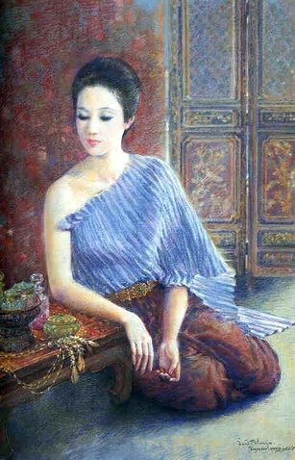
Thai Literature & Thai Society
01999032 Thai Studies

Slide 2
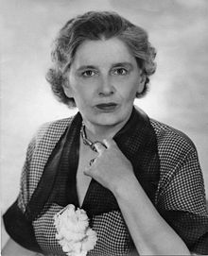
Literature and Its Definitions
The body of written works of a language, period, or culture.
Written artistic works, especially those with a high and lasting artistic value
Any kind of printed material
Imaginative or creative writing, especially
of recognized artistic value: “Literature
must be an analysis of experience and
a synthesis of the findings into a unity” (Rebecca West).
Rebecca West
(1892-1983)

Slide 3
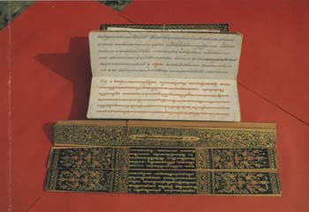
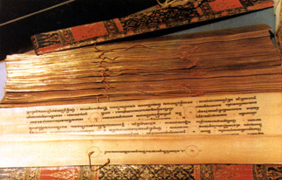
THE TERM “LITERATURE” IN THAI CONTEXT
1) หนังสือ (Nangseu) = a general written work
2) วรรณคดี (Wannakhadi) = a refined written work
(used in specific and general meaning)
3) วรรณกรรม (Wannakam) = literary works in written and oral tradition (used in general meaning)

Slide 4
Major Literary Genres : Prose & Poetry
Prose (Roykaew-ร้อยแก้ว)
- written language in its ordinary form
- a form of written language that is not organized according to the formal patterns of verse; although it will have some sort of rhythm and some devices of repetition and balance, these are not governed by a regularly sustained formal arrangement, the significant unit being the sentence rather than the line.

Slide 5
Major Literary Genres : Prose & Poetry
Poetry (Roykrong-ร้อยกรอง)
- literary work in metrical form
- language sung, chanted, spoken, or written according
to some pattern of recurrence that emphasizes
the relationships between words on the basis of sound
as well as sense: this pattern is almost always a rhythm
or metre, which may be supplemented by rhyme or alliteration or both.

Slide 6
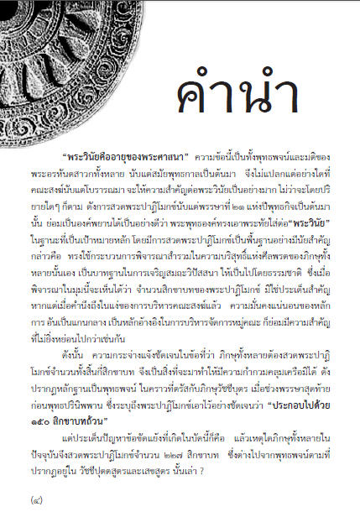
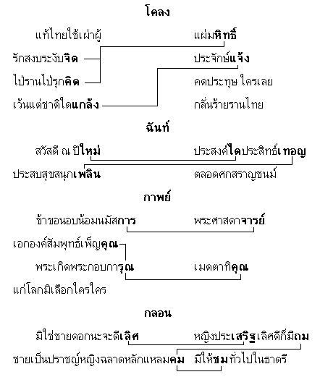
Prose vs. Poetry

Slide 7
Thai Poetry
Khlong
Chan
Kap
Klon

Slide 8
4 Periods of Thai Literature
Sukhothai Period (1238-1377)
Ayutthaya Period (1350-1767)
Thonburi Period (1767-1782)
Rattanakosin / Bangkok Period (1782-present)

Slide 9
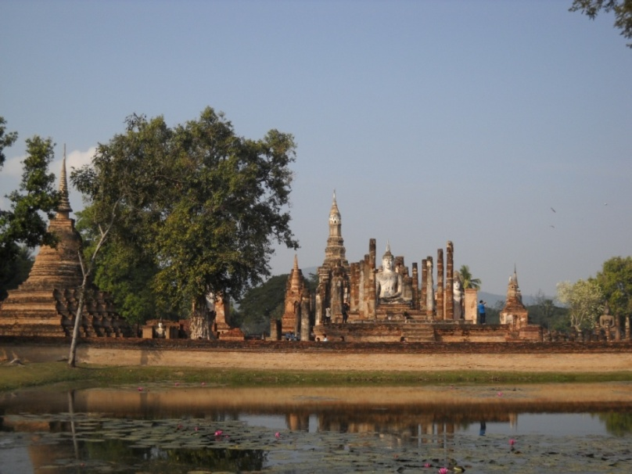
Sukhothai Literature (1238-1377)
Stone Inscription
- King Ram Kamhaeng Inscription (จารึกพ่อขุนรามคำแหง)
Traibhumikatha (ไตรภูมิพระร่วง)
Phra Ruang’s Proverb (สุภาษิตพระร่วง)

Slide 10
Characteristics of Sukhothai literature
- Historical Literature (stone inscription)
Sukhothai regime establishment (Sri-Chum inscription)
Religion (King Ram-Kamhaeng Inscription)
- Didactic Literature and Rhetorical Literature
Su-Pha-Sit Phra-Rueng สุภาษิตพระร่วง (proverbs)
Traibhumikatha ไตรภูมิพระร่วง (philosophic literature)
- Sacramental Literature
Ma-Ha-That Inscription จารึกวัดมหาธาตุ

Slide 11
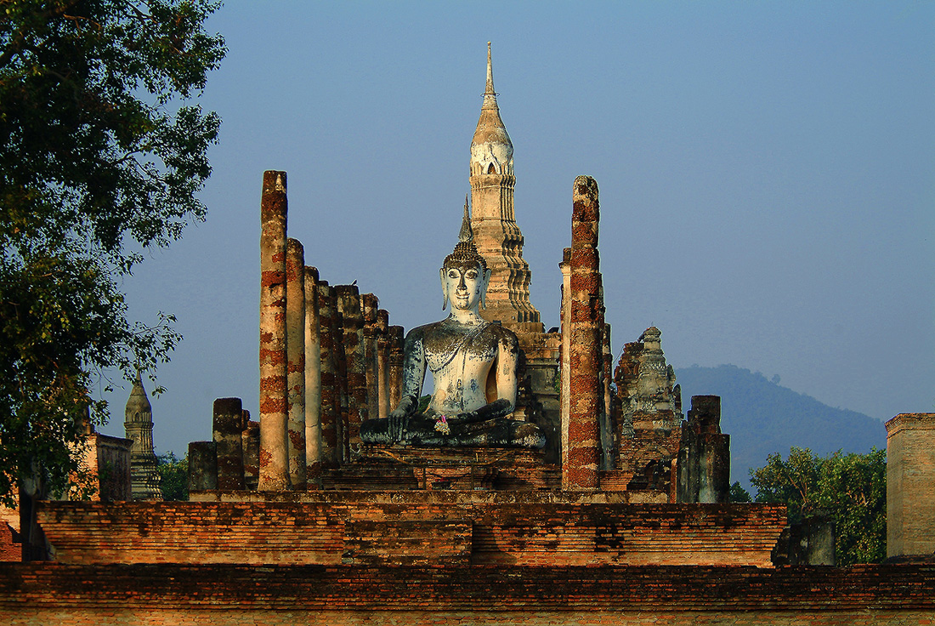
Sukhothai authors: King and Philosopher
Rhetorical style:
Short proses
Short sentences
Concise and well-arranged
Imaginative
Purpose:
1. to establish the kingdom
2. to make Sukhothai kingdom recognized (war, religion, King’s greatness)
3. to record Sukhothai history (stone inscriptions)
4. to systematize social order (proverbs and didactic literature)
5. to reunite the kingdom (sacramental literature)

Slide 12
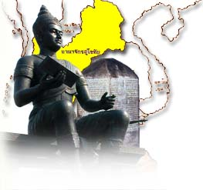
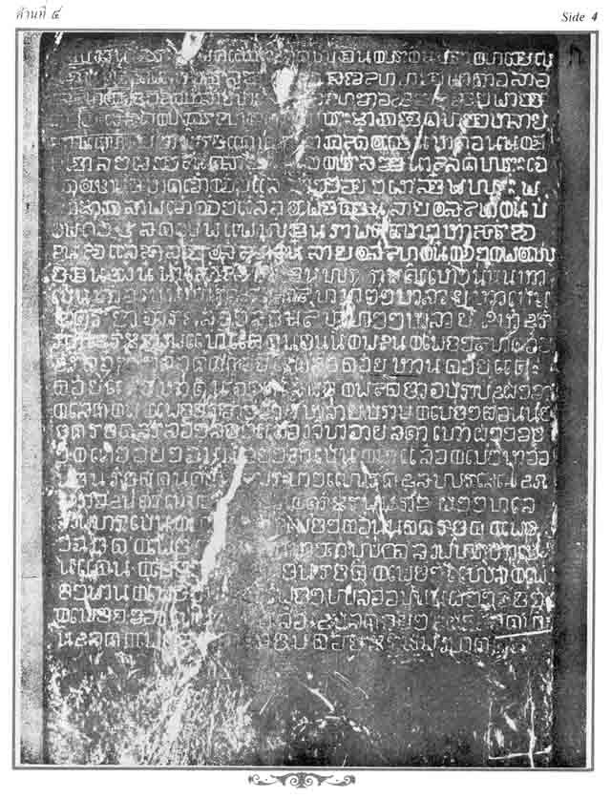
King Ram Kamhaeng Inscription (ศิลาจารึกพ่อขุนรามคำแหง)

Slide 13
King Ram Kamhaeng Inscription (ศิลาจารึกพ่อขุนรามคำแหง)
The first piece of work written in Thai script
(ลายสือไทย)
Content
Biography of King Ram Kamhaeng and his works
Description of Sukhothai social condition
Sukhothai landscape
Governance, Laws, Religion, and Trades

Slide 14
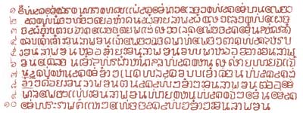

Slide 15
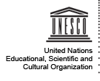
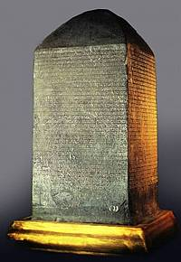
King Ram Kamhaeng Inscription
United Nations Educational, Scientific and
Cultural Organization (UNESCO)
certifies the King Ram Kamhaeng Insription
on the Memory of the World International
Register (2003) – 2546 B.E.

Slide 16
King Ramkamhaeng Inscription
The King Ram Khamhaeng Inscription
Documentary heritage submitted by Thailand and recommended for inclusion in the Memory of the World Register in 2003.
© The National Museum Bangkok
The King Ram Khamhaeng Inscription (RK) of 1292 A.D. is considered a major documentary heritage of world significance because it gives valuable information on several major themes of world history and culture. It not only records the invention of Thai language scripts that are the foundation of the modern scripts used in Thailand by 60 million people, its rare detailed description of the 13th century Thai state of Sukhothai also reflects universal values shared by many states in the world today. Those values include good governance, the rule of law, economic freedom, and religious morality, in this case Buddhism, one of the world's major religions. The inscription's value as a historical document has already been evident when it was used to support Thailand's successful proposal to inscribe the Historic Town of Sukhothai and Associated Historic Towns on the World Heritage List in 1991.

Slide 17
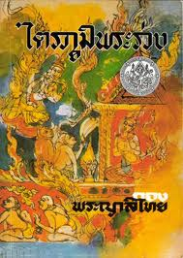
Traibhumikatha (ไตรภูมิพระร่วง)

Slide 18
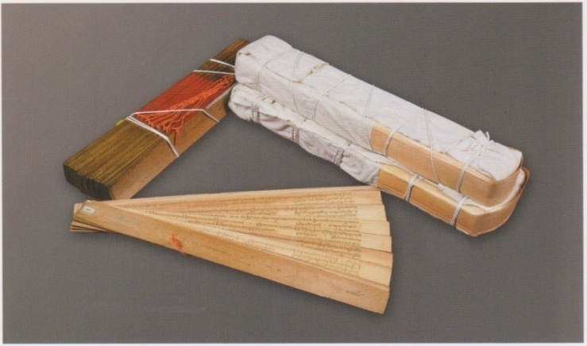
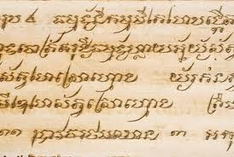
Traibhumikatha (ไตรภูมิพระร่วง)
Written by Phaya Lithai (พญาลิไท) or King Maha Thammaraja I in 1345.
It was used to give sermon to King’s mother and make merit to people.
Derived from collection and research through over 30 sacred texts
Written in beautiful rhythmic prose rich in allusions and imagery

Slide 19
Traibhumikatha: contents
It expounds Buddhist philosophy focused on cosmology (the study of the nature, structure, and origin of the universe).
This work is also a treatise on ethics, and the Buddhist faith.
Traibhum = Three realms; Sensuous realm, Form realm, Formless realm
It meticulously portrayed the picture of hell and heaven in order to control people’s behavior using Buddhist faith.
It promotes the divine status of the King since it mentions about Phraya Jakaphatdirat which is believed to be the first king of mankind. Phraya Jakaphatdirat can become king because of the acceptance from the people.

Slide 20
Traibhumikatha and the Buddhist Cosmos
Traibhum mean “3 Realms/Worlds”
1. Sensous realm (กามภูมิ)
2. Form realm (รูปภูมิ)
3. Formless realm (อรูปภูมิ)
Sensous realm comprised of human realm, animal realm, ghost realm, demon realm, hell, and heaven.
The highest being is Nirvana, formless or not-being.

Slide 21
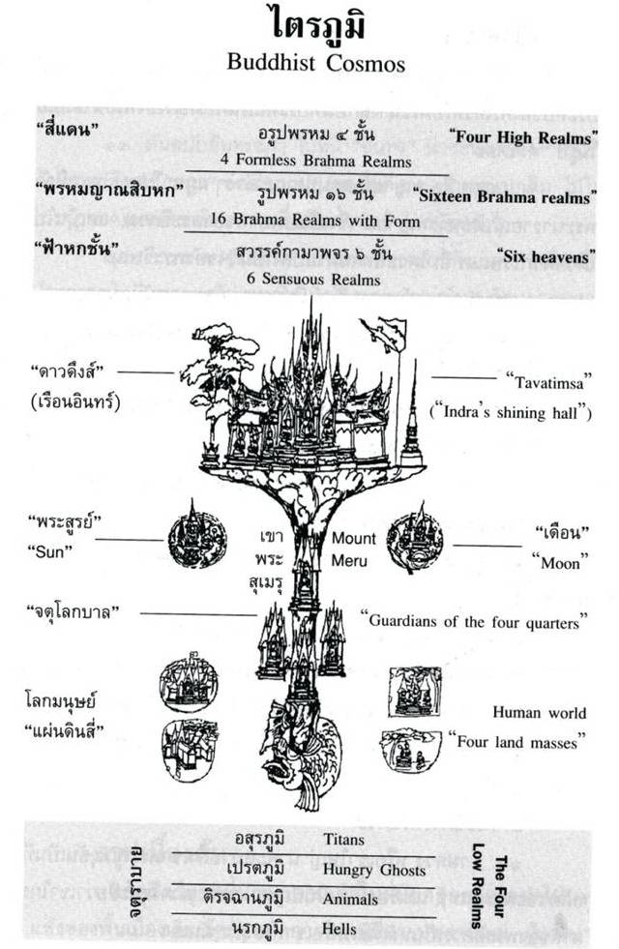

Slide 22
Traibhumikatha and the Buddhist Cosmos

Slide 23
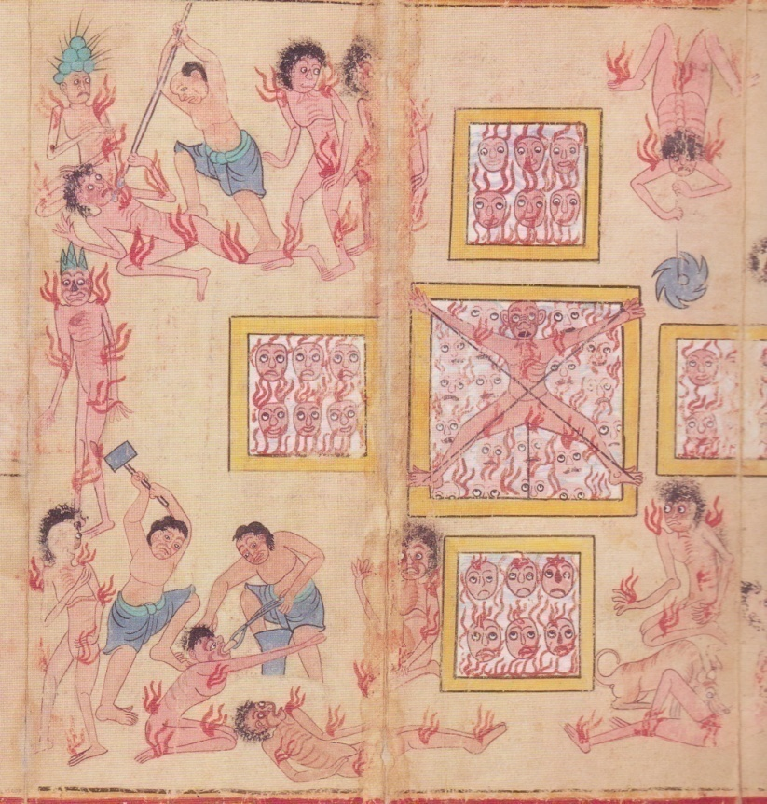
Traibhumikatha and the Buddhist Cosmos
the Maha Aviji
Hell

Slide 24
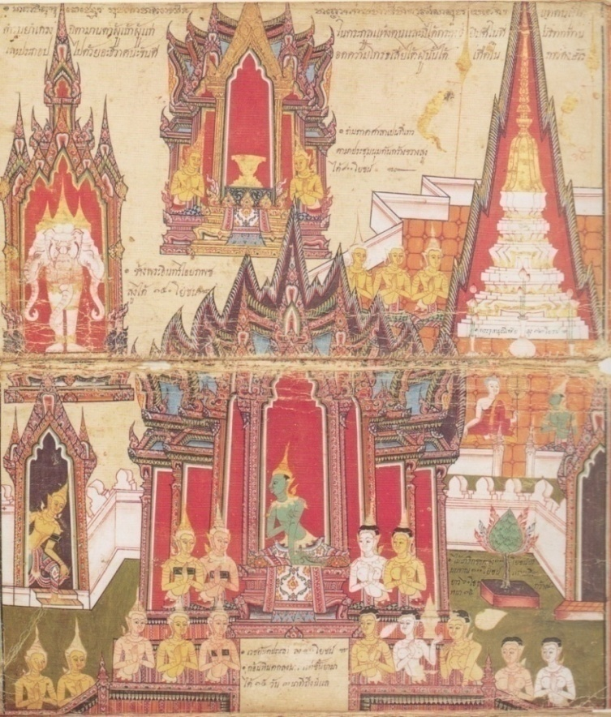
Traibhumikatha and the Buddhist Cosmos
the Tavatingsa
Heaven

Slide 25
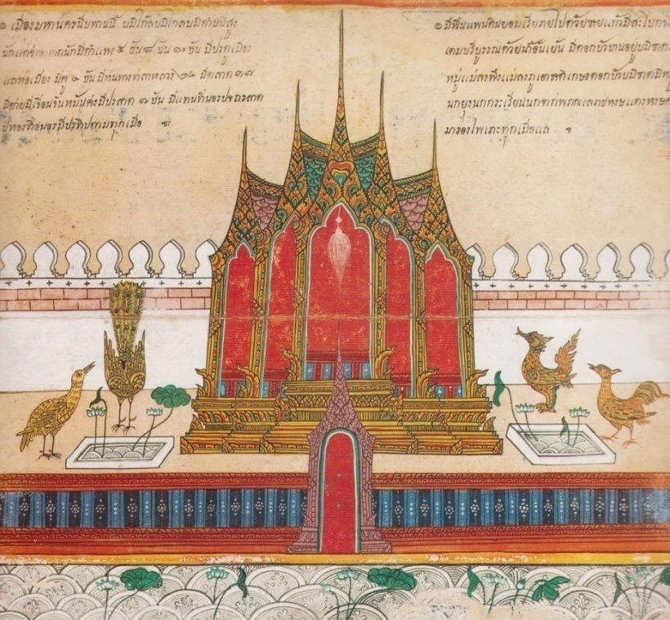
The aim of Buddhism
Nippan
or Nirvana

Slide 26
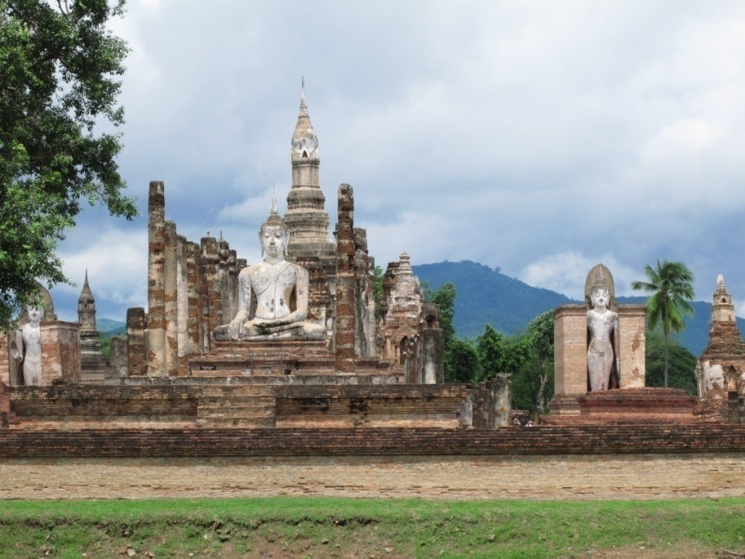
CONTENTS IN SUKHOTHAI LITERATURE
Historical accounts (บันทึกเหตุการณ์ประวัติศาสตร์)
Ethical practices (ส่งเสริมจริยธรรม)

Slide 27
Sukhothai literature indicates Thai writing style which has been developed until the present time.
Sukhothai literature emphasizes the Paternalism and ancient law in Thailand
Sukhothai literature reflects the unity of Sukhothai regime (the foreign immigrant, trading, agriculture)
Sukhothai artistic works and architecture (religious purpose)
The importance of Buddhism

Slide 28
AYUTTHAYA LITERATURE (1350-1767)

Slide 29
Characteristics of Ayutthaya Literature
400 years of the absolute monarchy
Social classes: 1. the rulers (kings and aristocrats) 2. the citizens (the folks and slaves) under patronage system
Agriculture and foreign trade (under the state’s control)
The factors effected Ayutthaya literature 1893-2172 B.E. : Kingdom expansion, under colony, enthronement war
Three periods of Ayutthaya literature:
1. Early Ayutthaya period 1893-2172 B.E.
2. Middle Ayutthaya 2172-2231 B.E.
3. Late Ayutthaya 2231-2310 B.E.

Slide 30
Ayutthaya rhetoric style: Klong and Rai (Thai long rhetorical verse)
Religious literature
Paean/ Ovation/ Royal hymn
Historical literature (tales, novels, poet’s expression and ceremonial literature)

Slide 31
CONTENTS IN AYUTTHAYA LITERATURE
Promote Absolute Monarchy /
Royal Institution
(ส่งเสริมสถาบันพระมหากษัตริย์)
Prolong Buddhist Doctrine
(สืบทอดพระพุทธศาสนา)
Praise Emotive Expression
(เชิดชูคุณค่าทางอารมณ์)

Slide 32
Ongkan Chaeng Nam / oath of allegiance
Early Ayutthaya believes (Brahman + Buddhism + Ghost) effected Politics
Li-Lit Yuan Phai (verse of Yuan Burmese defeat)
To publicize King’s greatness and historical events
Klong-Kum-Suan (oath of lament)
Beautiful rhetorical style and the prototype of Ni-Rat (to be exiled to a distant place)

Slide 33
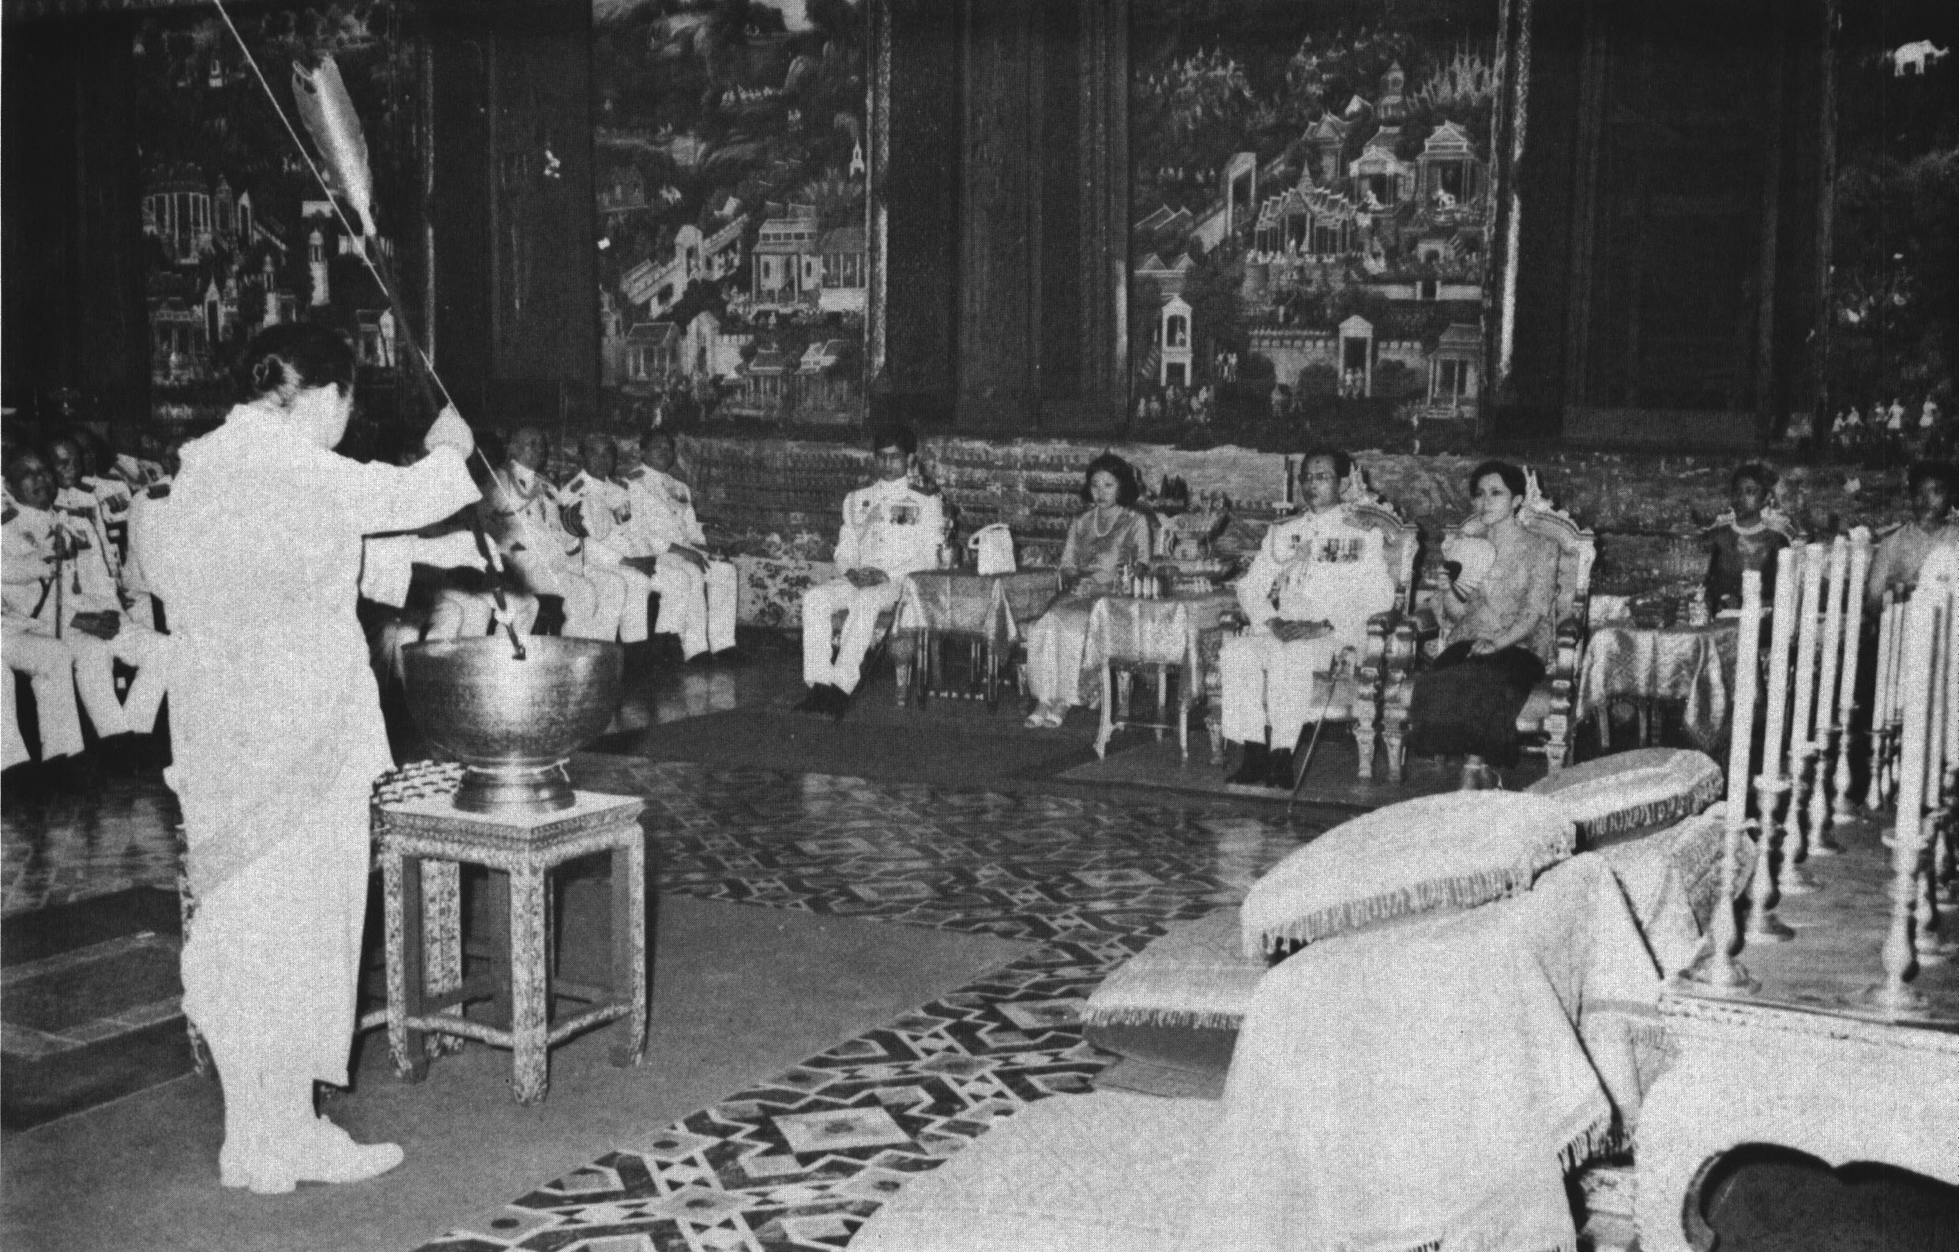
Promote Absolute Monarchy / Royal Institution
Ongkan Chaeng Nam / oath of allegiance (โองการแช่งน้ำ)

Slide 34
Ongkan Chaeng Nam / Oath of allegiance
Written in the founding period of Ayutthaya in the King Au Thong’s era (พระเจ้าอู่ทอง)
Was used in the Oath of allegiance ceremony which all bureaucrats, noblemen, royal families, and the leaders of colony states had to attend.
It was a ritual to promote loyalty and close domestic and foreign alliances

Slide 35
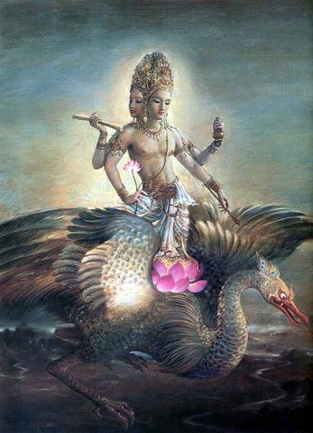
Ongkan Chaeng Nam / oath of allegiance
Perform worship to Hindu gods (Brahma, Vishnu/ Narai, Shiva)
Inviting the gods to be witnesses in the ceremony
Comprise of curse words to one who’s disloyal to king.

Slide 36
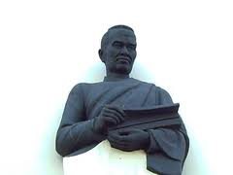
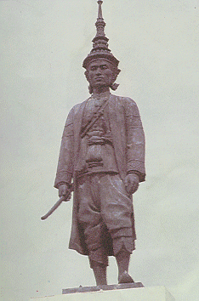
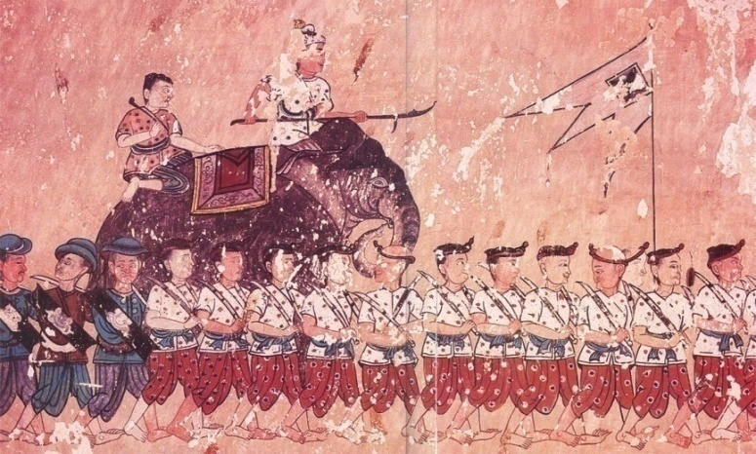
Promote Absolute Monarchy / Royal Institution
Eulogies for Kings
- Yuan Phai Khlong Dan (ยวนพ่ายโคลงดั้น)
- Verses of Glorifying to King Narai
(โคลงเฉลิมพระเกียรติสมเด็จพระนารายณ์)

Slide 37
Yuan Phai Khlong Dan (ยวนพ่ายโคลงดั้น)
Yuan Phai Khlong Dan or “The defeating of Yuan”
Yuan = The north kingdom = Chiang-Mai
Portrayed the battle between Ayutthaya (leading by King Trailokanart) and Chiang- Mai (King Tilokarat) in the early Ayutthaya era
It’s the eulogies for King Trailokanart (สมเด็จพระบรมไตรโลกนาถ) presenting his biography, works, and glory

Slide 38
Verses of Glorifying to King Narai (โคลงเฉลิมพระเกียรติสมเด็จพระนารายณ์)
It’s the eulogies for King Narai (สมเด็จพระนารายณ์) one of the great king in the mid-Ayutthaya period
It recorded the historical events in his reign such as the obtaining of white elephant, war, allegiance of foreign kings.

Slide 39
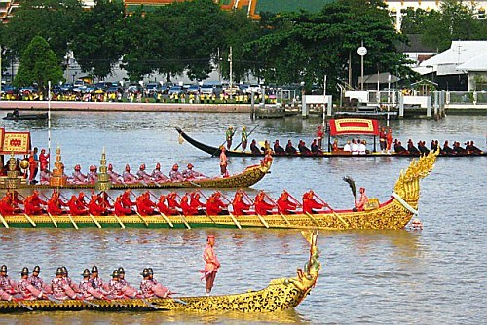
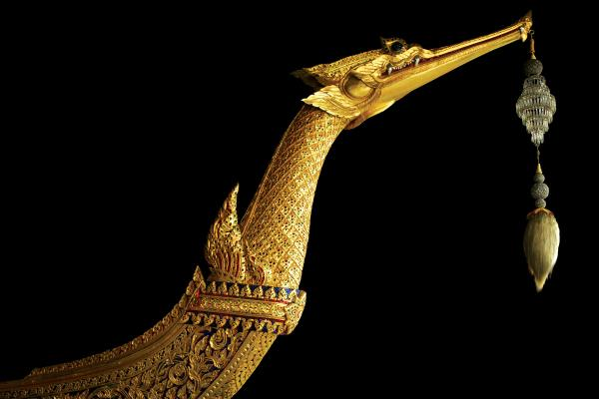
Promote Absolute Monarchy / Royal Institution
The Royal Procession
- Kapya Hae Rua (กาพย์เห่เรือ) or The royal barge chant
- It was used in the royal barge ceremony since the late Ayutthaya period
- Its contents depict the exquisite part of the barges and nature surround it such as trees, fish and birds

Slide 40
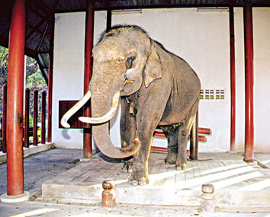
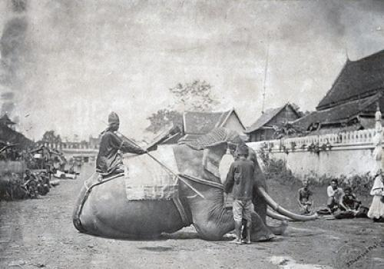
Promote Absolute Monarchy / Royal Institution
The Royal Procession
- Chan Klom Chang (ฉันท์กล่อมช้าง) or The elephant taming chant
- It was used in the white elephant taming ritual (white elephant has been considered to be the most important property for the king)

Slide 41
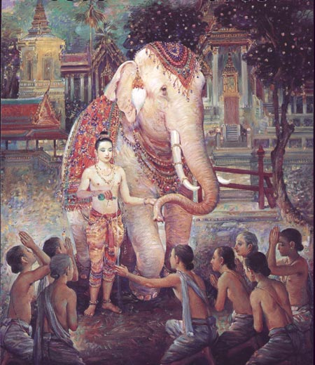
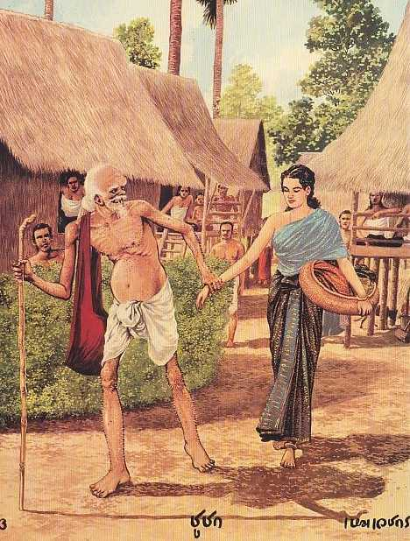
Prolong Buddhist doctrine
Religious literatures
- Mahajati Kham Luang (มหาชาติคำหลวง)

Slide 42
Mahajati Kham Luang (มหาชาติคำหลวง)
The story about the former Life of Bhotisatva (พระโพธิสัตว์) as Vessantara (พระเวสสันดร) before becoming Buddha
Presenting the ethic and value of sacrificing or Thana (ทาน)
It has been used in Mahajati Sermon ceremony (เทศน์มหาชาติ) till the present time
Buddhists believe that the merit of listening to the sermon completely in one day will bring ones to heaven or reborn in the Mettraiya era (ยุคพระศรีอารย์)

Slide 43
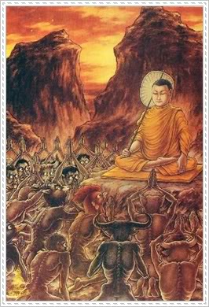
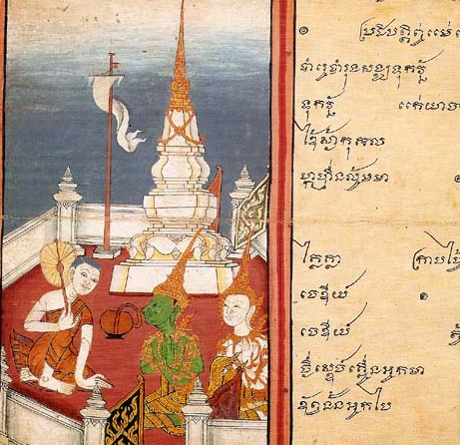
Buddhist doctrine
Religious literatures
- Phra Malai Kham Luang (พระมาลัยคำหลวง)
Represents images of hell and heaven
Encourages people to make merit and give charity

Slide 44
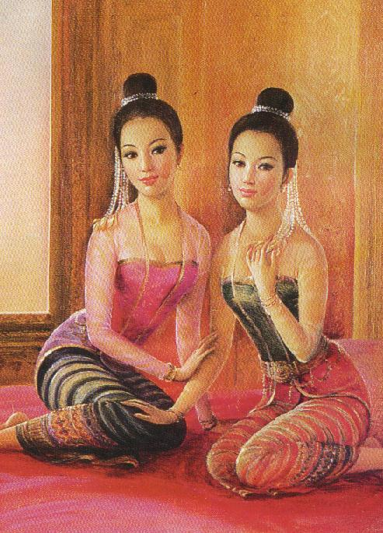
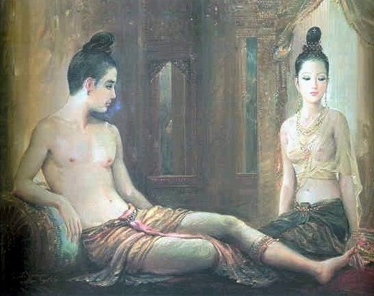
Emotive expression
Romantic tales
- Lilit Phra Lo (ลิลิตพระลอ) The tragic love story between the heirs of the two hostile kingdoms. The plot came from a folk tale in the north of Thailand

Slide 45
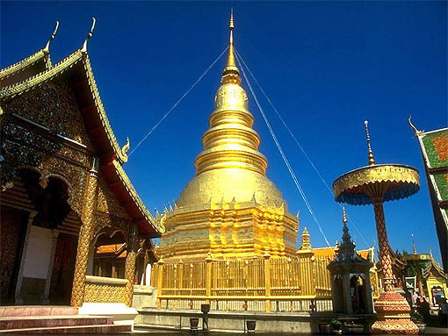
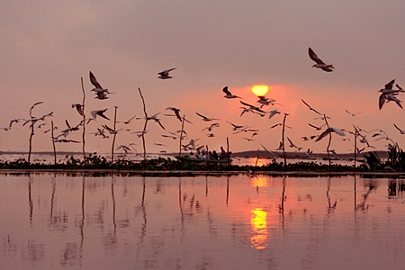
Emotive expression
Nirat (the parting from loved ones)
- Khlong Thawa Thotsamat (โคลงทวาทศมาส)
- Kam Suan Khlong Dan (กำสรวลโคลงดั้น)

Slide 46
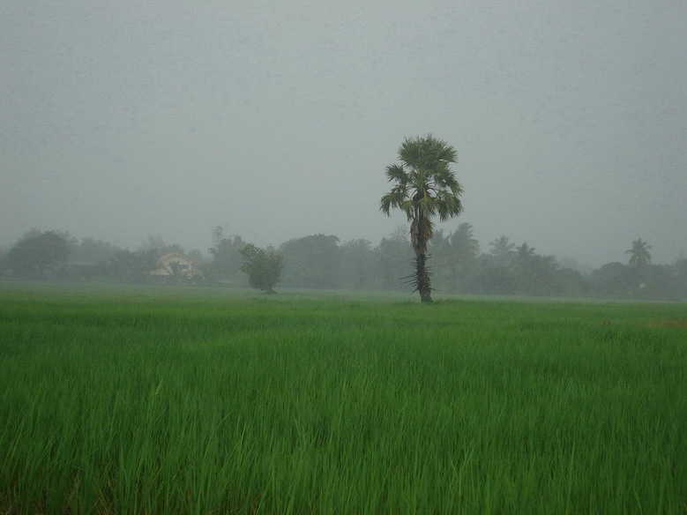
Nirat
- Khlong Thawa Thotsamat (โคลงทวาทศมาส)
moaning to the love one using time (month/season) as medium
- Kam Suan Khlong Dan (กำสรวลโคลงดั้น)
account the travel to Nakornsrithammarat in the sea and express feeling toward the love one along the way

Slide 47
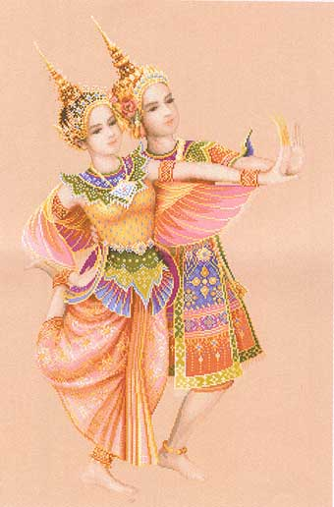
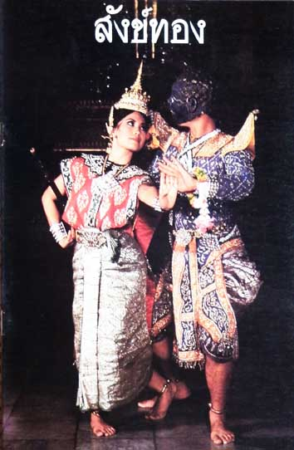
Emotive expression
Performing literatures (Dance drama/Lakorn)
- Inao (อิเหนา) adapted from Java tale
- Sangthong (สังข์ทอง)
- Manohra (มโนห์รา)
Thai fairy tales/Jak Jak Wong Wong

Slide 48
Ayutthaya literature observation
Authors and periods were ambiguous
Literature was King’s tool of governance
Ayutthaya literature is the prototype of Rattanakosin literature
Ayutthaya literature reflects Brahman + Buddhism + Ancient believes
Ayutthaya literature were influenced by foreign literary works (adapted to Thai literary taste)
Image of Ayutthaya lifestyle and society weren’t so explicit through literature (mainly focused on royal literature)
Ayutthaya literature portrays Politics, Economics, social order and lifestyle in some aspects.

Slide 49
THONBURI LITERATURE (1768-1782)

Slide 50
After Ayutthaya regime---Thonburi regime was established
The leader wanted to reunite, reestablish the kingdom abruptly
Thonburi politics, economics and society included arts and cultures were transferred from the late Ayutthaya period
Thonburi was in crisis and patronized by the king (warrior) but there were some poets
Thonburi literature was conservative style and imitated the early period

Slide 51
The distinctive literary works reflect the aristocrats’ feeling to the leader impressively
Tales and novels
King’s eulogy
Emotional expression
Didactic literature

Slide 52
CONTENTS IN THONBURI LITERATURE
Ayutthaya’ s heritage
- Royal Institution : The Eulogy for King Tak Sin
- Play : Ramakien / Inao
King Tak-Sin composed 4 Ramakien chapters
- Didactic : Krishsana Sorn Nong (Krishsana teaching her sister)

Slide 53
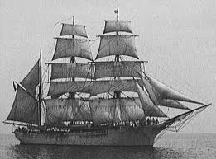
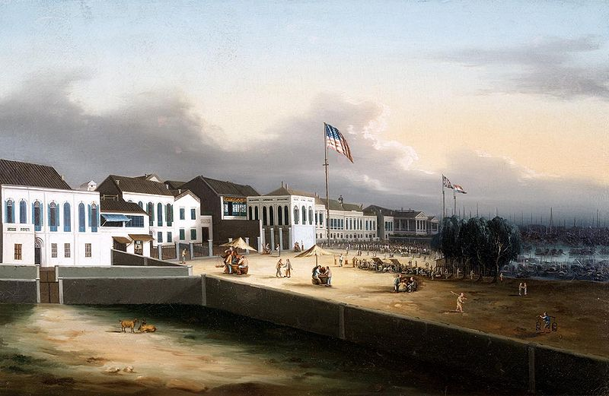
THONBURI LITERATURE
Historical Account
Nirat Phraya Mahanuphap or Nirat Kwangtung (Royal ambassador travel to Kwangtung)
- an account of foreign travel in verse

Slide 54
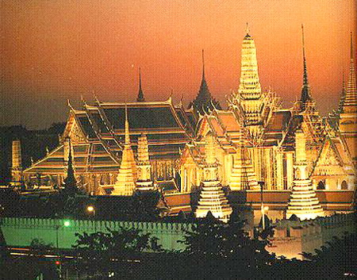
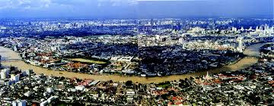
RATTANAKOSIN LITERATURE (1782- PRESENT)
Rattanakosin Literature During 1782-1932
Contemporary Literature (1932- present)

Slide 55
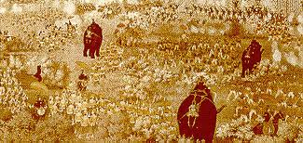
Rattanakosin Literature During 1782-1932
Records of historical events
- Phleng Yao Nirat Rob Phama Thi Tha Dindaeng (Nirat on fighting the Burmese at Tha Dindaeng, เพลงยาวนิราศรบพม่าที่
ท่าดินแดง)
Record the event of war in the reign of king Rama I between Siam and Burma

Slide 56
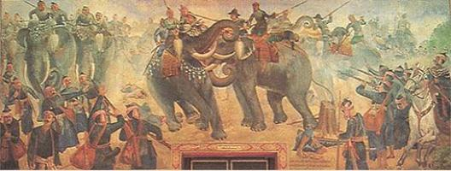
Rattanakosin Literature During 1782-1932
Records of historical events
- Lilit Taleng Phai (ลิลิตตะเลงพ่าย) Inspired by the real event of battle between King Naresuan of Ayutthaya and the prince of Burma

Slide 57
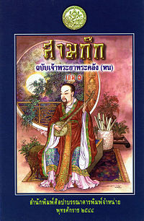
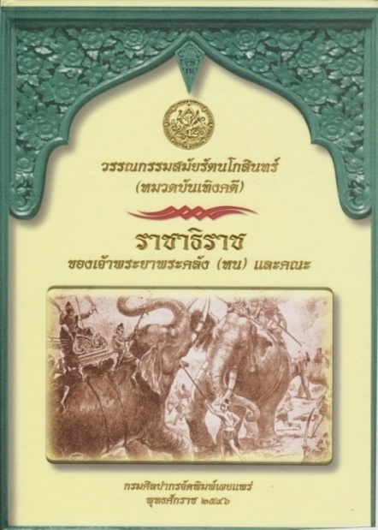
Rattanakosin Literature During 1782-1932
The Chronicles
- Chronicle by Phanchanthanumat (พงศาวดารฉบับพันจันทนุมาศ) recorded history of Ayutthaya till early Rattanakosin
- Samkok (สามก๊ก) translated from Chinese chronicle
- Rachathirat (ราชาธิราช)
translated from Mon chronicle

Slide 58
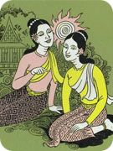
RATTANAKOSIN LITERATURE 1782-1932
Sermons and Proverbs
- Krishna Son Nong Kham Chant (Krishna’s Didactic poem for women, กฤษณาสอนน้องคำฉันท์)
- Supasit Sonying (Ladies’ Proverbs, สุภาษิตสอนหญิง)
- Loka Niti Kham Khlong (Loka Niti Proverbs, โลกนิติคำโคลง)

Slide 59
RATTANAKOSIN LITERATURE 1782-1932
Buddhist literature
- Pathomsomphothikatha (the life of the Lord Buddha,
ปฐมสมโพธิกถา)
- Rattanapimpawong (the legend of emerald Buddha,รัตนพิมพวงศ์)

Slide 60
RATTANAKOSIN LITERATURE 1782-1932
Literary tales
- Pra Aphai Manee (พระอภัยมณี)

Slide 61
RATTANAKOSIN LITERATURE 1782-1932
Literary tales
- Khun Chang Khun Phaen (ขุนช้างขุนแผน)

Slide 62
RATTANAKOSIN LITERATURE 1782-1932
Literature for performance (Drama/Lakorn)
- Ramakien (รามเกียรติ์) (Thai Ramayana)
- Inao (อิเหนา)

Slide 63
RATTANAKOSIN LITERATURE 1782-1932
Fiction
Mae Wan (pseudonym - แม่วัน) and emergence of contemporary Thai literature.
The First Thai novel is Kwamphayabat translated from “Vendetta” by Mary Corelli

Slide 64
CONTENTS OF RATTANAKOSIN LITERATURE
Reconstruction of Arts and Letters (ฟื้นฟูอักษรศาสตร์)
Human Resources (สร้างคุณภาพคน)
Romance (ประโลมโลก)
Social Criticism (วิจารณ์สังคม)
Nationalism (ปลุกใจให้รักชาติ)
Literary Convention (โบราณนิยม)
Foreign Literary Influences
(ผสมผสานอิทธิพลจากต่างชาติ)

Slide 65
Reconstruction of Arts and Letters
The performing art literature (King Rama I-II)
- Ramakien
- Inao
- Sangthong

Slide 66
Human Resources
The didactic literature (King Rama I-III)
- Loka Niti Kham Khlong (Loka Niti Proverbs)
- Supasit Sonying (Ladies’ Proverbs)

Slide 67
Romance
Tales
- Khun Chang Khun Phaen
- Pra Aphai Manee

Slide 68
Social Criticism
Journal – the articles and essays (King Rama IV-VI)
- Jodmai Jangwang Ram (Jangwang Ram’s Letter, จดหมายจางวางหร่ำ)
- Klong Klon Kong Kru Thep (Kru Thep’s poetry, โคลงกลอนของครูเทพ)

Slide 69
Nationalism
Plays
- Huajai nakrob (The warrior’s Spirit, หัวใจนักรบ)
Essays
Wake up Thai! (เมืองไทยจงตื่นเถิด)

Slide 70
Literary Convention
Buddhist literature
- Rai Mahachat (Vessantara Jataka, the great life, ร่ายมหาชาติ)
Traditional literary form
Lilit, Kham Luang, Kham chand

Slide 71
Foreign Literary Influences
Literary works from the eastern countries
- Sakuntala (ศกุนตลา)

Slide 72
Foreign Literary Influences
Literary works from the western countries
- The Merchant of Venice Venice Vanit

Slide 73
RATTANAKOSIN LITERATURE 1782-1932
Western Influence
Nirat London
(นิราศลอนดอน)
Archives of Thai Ambassador's visit to London
(จดหมายเหตุราชทูตไทย
ไปกรุงลอนดอน)

Slide 74
RATTANAKOSIN LITERATURE 1782-1932
King Rama VI and PrinceBidyalongkorn: Works adapted from Foreign Literature

Slide 75
King Rama VI and Prince Bidyalongkorn Works in relation to Foreign Literature
Foreign Influences on King Rama VI’s works
Shakespeare’s Play
European Play
Journalism
Sanskrit Literature
Foreign Influences on Prince Bidyalongkorn’s Works
Western Fiction
Journalism
Sanskrit Literature

Slide 76
CONTEMPORARY LITERATURE (1932-PRESENT)

Slide 77
CONTENT of CONTEMPORARY LITERATURE
Romance

Slide 78
CONTENT of CONTEMPORARY LITERATURE
Promoting Social Classes Equality

Slide 79
CONTENT of CONTEMPORARY LITERATURE
“Literature For Life Sake” (วรรณกรรมเพื่อชีวิต)
or socialism influenced literature

Slide 80
CONTENT of CONTEMPORARY LITERATURE
Against Communism
Promote Monarchy

Slide 81
CONTENT of CONTEMPORARY LITERATURE
rural problem
urban problem

Slide 82
CONTENT of CONTEMPORARY LITERATURE
Political Issue

Slide 83
CONTEMPORARY LITERATURE (1932-PRESENT)
THE S.E.A. WRITE AWARDS (Southeast Asian Writers Award)
- an award that is presented annually since 1979 to poets and writers of Southeast Asia

Slide 84
THE S.E.A. WRITE AWARDS
Novel

Slide 85
THE S.E.A. WRITE AWARDS
Short Stories

Slide 86
THE S.E.A. WRITE AWARDS
Poetry

Slide 87
2015 S.E.A WRITE AWARD SHORT LIST (Novel)

Slide 88
2015 S.E.A WRITE AWARD (Novel)

Slide 89
THEMES AND CONTENTS OF CONTEMPORARY LITERATURE
Socio-Political Criticism (วิจารณ์สังคมและการเมือง)
The Escapists (หลีกหนีความเป็นจริง)
Art for Life’s Sake (ศิลปะเพื่อชีวิต)
Influences of World Literature (ตามกระแสวรรณกรรมโลก)

Slide 90
THAI LITERATURE AND THE OTHER ARTS

Slide 91
THAI LITERATURE AND VISUAL ARTS: ARCHITECTURE
Traibhum

Slide 92
THAI LITERATURE AND VISUAL ARTS: PAINTING
Ramakien
(รามเกียรติ์)

Slide 93
THAI LITERATURE AND VISUAL ARTS: PAINTING
Lilit Phra Lo (ลิลิตพระลอ) Kaki (กากี)

Slide 94
THAI LITERATURE AND VISUAL ARTS: SCULPTURE
Kraithong (ไกรทอง)

Slide 95
THAI LITERATURE AND PERFORMING ARTS: SHADOW PLAY
Ramakien (รามเกียรติ์)

Slide 96
THAI LITERATURE AND PERFORMING ARTS: PUPPET
Sangthong (สังข์ทอง)

Slide 97
THAI LITERATURE AND PERFORMING ARTS: DANCE DRAMA
Khon – Ramakien (โขน – รามเกียรติ์)

Slide 98
THAI LITERATURE AND PERFORMING ARTS: DANCE DRAMA
Lakon Nai, the dance drama in the royal court
Inao (อิเหนา)

Slide 99
THAI LITERATURE AND PERFORMING ARTS: CONTEMPORARY DANCE
Ramakien (รามเกียรติ์) - Narai defeating Nonthok

Slide 100
THAI LITERATURE AND PERFORMING ARTS: Khukam - คู่กรรม

Slide 101
THAI LITERATURE AND PERFORMING ARTS: TV Series

Slide 102
THAI LITERATURE AND PERFORMING ARTS: the Film

Slide 103
THAI LITERATURE AND PERFORMING ARTS: Musical Play

Slide 104
Sawasdee

